Slide 1
Lecture LA03:
Site Navigation
ITP271 :: Web Application Development & Project

Slide 2

Introduction to Web Site Navigation
Instead of hard coding navigation links in html as in previous example, it is better to store them in files for easy maintenance.
In ASP.NET, site information is stored in an XML site map file, which, by default, has the file name web.sitemap

Slide 3
Introduction to Web Site Navigation
Web.sitemap
File
XMLSiteMapProvider
SiteMap
Api
SiteMapDataSource
SiteMap
Path
Menu
XML file defining structure of web site
SiteMap Provider that reads from sitemap file and generating a sitemap object
Navigation Controls
TreeView
SiteMapDataSource uses sitemap object and provides site info to navigation controls

Slide 4
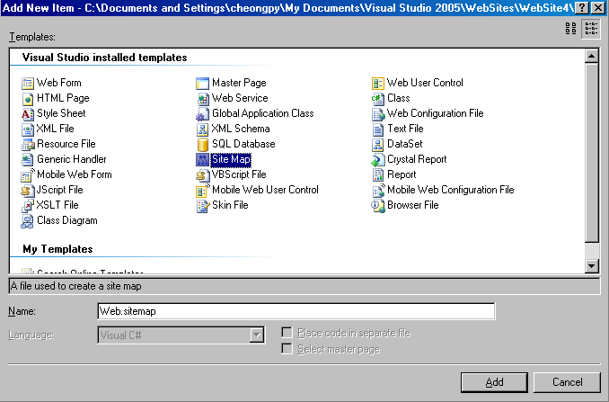
How to create a site map file
Choose Web Site→ Add New Item-→Site Map

Slide 5
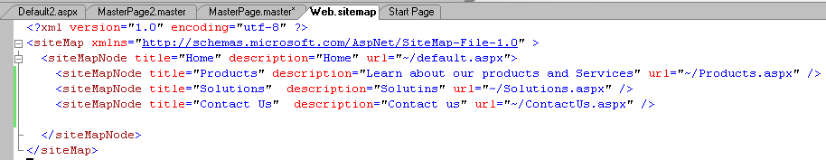
Defining a Site Map
A site map
  Begins with <siteMap> element
  Begins with a Single <siteMapNode>. All other nodes are child of this node
  Cannot have duplicate URLs. This is because URLs are used for indexing
Web.siteMap file

Slide 6
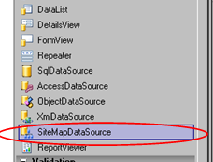
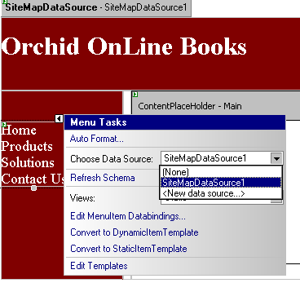
How to bind a web page to a site map
Drag a SiteMapDataSource from ToolBox into web form. This control will automatically reference site information from web.sitemap
Drag a navigational control (shown here is a Menu) from ToolBox and make reference to SiteMapDataSource

Slide 7
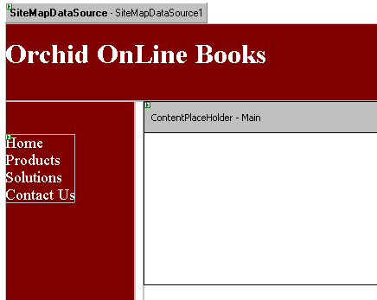

How to bind a web page to a site map
Typically, since navigational controls such as Treeview and Menu appears on every web page, these controls are used with Master Pages
Navigational Controls
Menu bound to SiteMapDataSource

Slide 8

SiteMapPath
Display the path of the web page within a web application

Slide 9
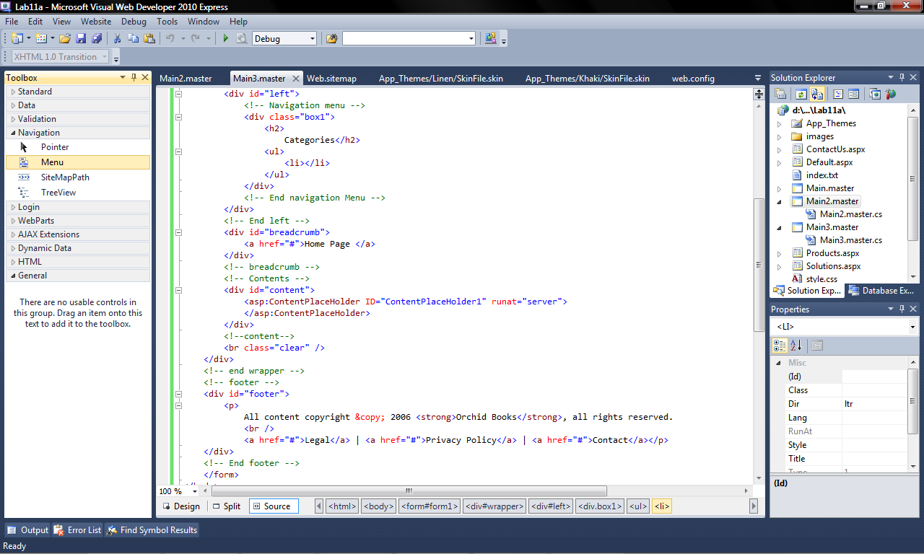
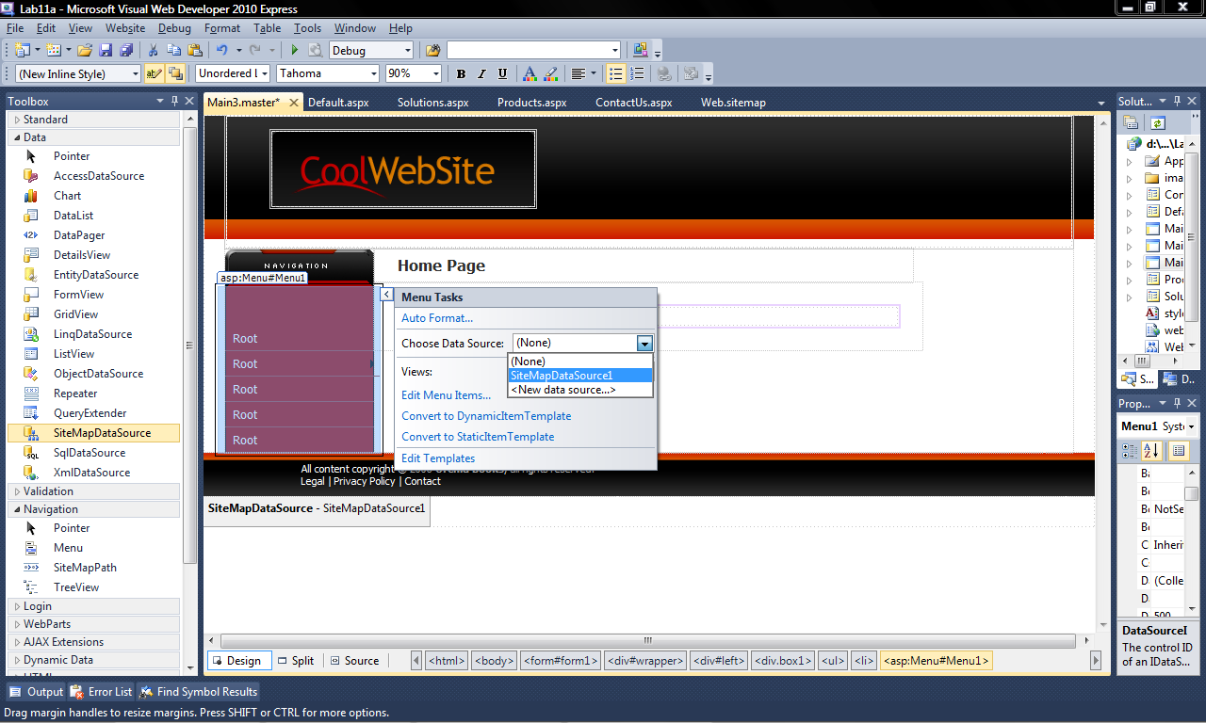
Menu
Develop displayed menus for web page
Bind the sitemap to SiteMapDataSource
Menu then uses the SiteMapDataSource

Slide 10
Further reading
ASP.NET Site Navigation Overview
msdn2.microsoft.com/en-us/library/e468hxky.aspx

Slide 11
End of Lecture
Use sitemap to create navigation

